Slide 1
Databases Design. Introduction to SQL LECTURE 4 Normalization. Normal Forms
IITU, ALMATY, 2020

Slide 2
Last lecture
Update anomalies
Modification
Insertion
Deletion
Functional dependencies
Full
Partial
Transitive

Slide 3
Today’s lecture
We'll speak about normalization and normal forms
You'll know what a normal form corresponds to a “good” design
We'll discuss how we can improve a database design

Slide 4
Database Design
Stages
Subject Area Analysis
Conceptual Design
Logical Design
Physical Design

Slide 5
Normalization
Normalization is used to test the correctness of a logical data model. The logical data model is a source of information for the next phase - Physical database design
Normalization – is a process of decomposing complex relations into simple relations in order to remove unwanted functional dependencies and data redundancy within complex relations

Slide 6
Normal Forms
The Normal Forms (NF) of relational database theory provide criteria for determining a table's degree of immunity against logical inconsistencies and anomalies
The normal forms are applicable to individual tables; to say that an entire database is in normal form n is to say that all of its tables are in normal form n

Slide 7
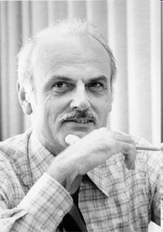
History
Edgar F. Codd, the inventor of the relational model, introduced the concept of normalization and what we now know as the First Normal Form (1NF) in 1970
Codd went on to define the Second Normal Form (2NF) and Third Normal Form (3NF) in 1971, and Codd and Raymond F. Boyce defined the Boyce-Codd Normal Form (BCNF) in 1974

Slide 8
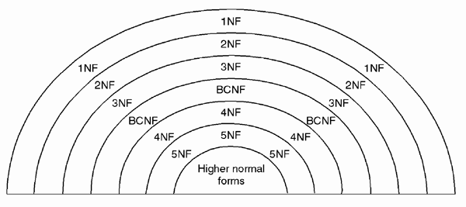
Normal Forms
Relational tables are classified into various normal forms based on the existence of various types of functional dependencies
Types of functional dependencies leads to over five normal forms

Slide 9
“Good” design
Normalization is executed as a series of steps. Each step corresponds to a specific normal form that has known properties
As normalization proceeds, the relations become progressively more restricted (stronger) in format and also less vulnerable to update anomalies
3NF is the standard normal form that a relation may be in to be considered a “good” design
3NF tables are free of insertion, modification (update), and deletion anomalies

Slide 10
First Normal Form (1NF)
Relation is in First Normal Form (1NF) if each column is a single, atomic value
Relation is in 1NF if every cell in the table contains one and only one value
Relation that is not in 1NF is known as unnormalized or UNF (0NF). A relation that is in UNF will have composite of multi-valued attributes

Slide 11

First Normal Form
The table below stores teachers and departments information
This table is in 1NF because every attribute is atomic

Slide 12
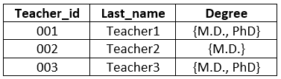
First Normal Form
Consider the relation Teachers below
It is in UNF (not in 1NF)

Slide 13
Decomposition
Decomposition is the process of breaking down in parts or elements
It breaks the table into multiple tables in a database
It should always be lossless, because it confirms that the information in the original relation can be accurately reconstructed based on the decomposed relations

Slide 14

Decomposition to 1NF
Relation Teachers violates 1NF
To bring it to 1NF, we remove multi-valued attribute and create new relation out of it
If a relation violates 1NF by having a composite attribute, it needs to be break down into simple attributes (FIO – first name, last name)

Slide 15
Second Normal Form (2NF)
Relation that is in Second Normal Form (2NF) is in 1NF and has no partial dependencies on the PK
Second normal form is associated with modification anomaly
If a relation has a simple PK (one attribute), it is in 2NF automatically
Only relations with composite PK (two ore more attributes) must be checked against 2NF

Slide 16
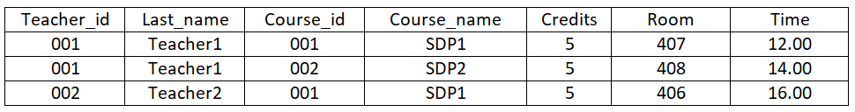
Partial dependency
A dependency X -> Y is a partial dependency if there exists an attribute A that is part of X that can be removed from X and the dependency still holds
Example: TeachersAndCourses relation
PK is {teacher_id, course_id}

Slide 17
Partial dependency
Also suppose this relation has the following dependencies:
FD1: {teacher_id, course_id} -> {room, time}
FD2: {teacher_id} -> {last_name}
FD3: {course_id} -> {course_name, credits}
last_name, course_name, credits are partially dependent on the PK
room and time are fully dependent on PK

Slide 18
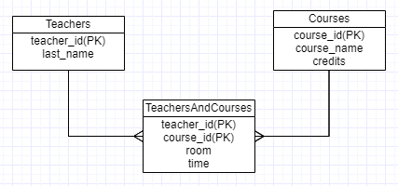
Decomposition to 2NF
Relation TeachersAndCourses violates 2NF
To bring it to 2NF, we remove partial dependencies and create new relations out of them

Slide 19
Third Normal Form (3NF)
Relation is in Third Normal Form (3NF) if it is in 2NF and it contains no attributes that are transitively dependent on the Primary Key
Third normal form is defined in terms of transitive dependencies and is associated with insertion and deletion anomalies

Slide 20

Transitive dependency
Transitive dependency is a condition where X, Y, and Z are attributes of a relation such that if X→Y and Y→Z, then Z is transitively dependent on X via Y
Example: StudentsAndGroups relation
PK is student_id

Slide 21
Transitive dependency
The relation has the following functional dependencies:
{student_id} -> {last_name, group_id}
{group_id} -> {group_name}
This relation contains a transitive dependency because
{student_id} -> {group_id} -> {group_name}

Slide 22
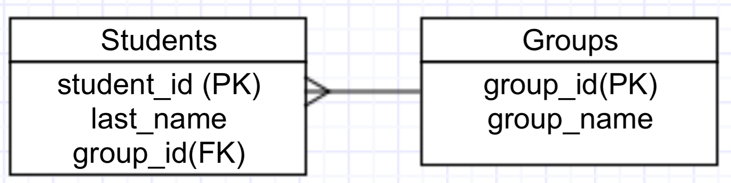
Decomposition to 3NF
Relation StudentsAndGroups violates 3NF
To bring it to 3NF we need to remove the transitive dependency from the relation by removing it into a new relation

Slide 23
Summary
Typically, a 3NF relation is considered a good database design – the normalizing process usually ends once 3NF is attained
How do we remove functional dependencies that violate a given normal form?
We break a relation into many smaller relations while still maintaining the relationship among the data

Slide 24
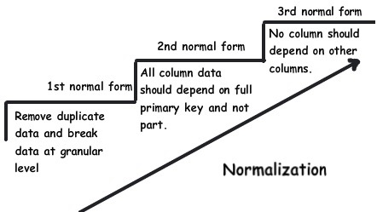
Summary

Slide 25
Examples for Course Work. Part 3

Slide 26
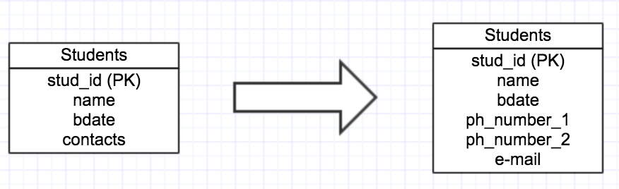
Case 1: UNF to 1NF (vers. 1)
Contacts was divided like ph_number_1, ph_number_2, e-mail

Slide 27
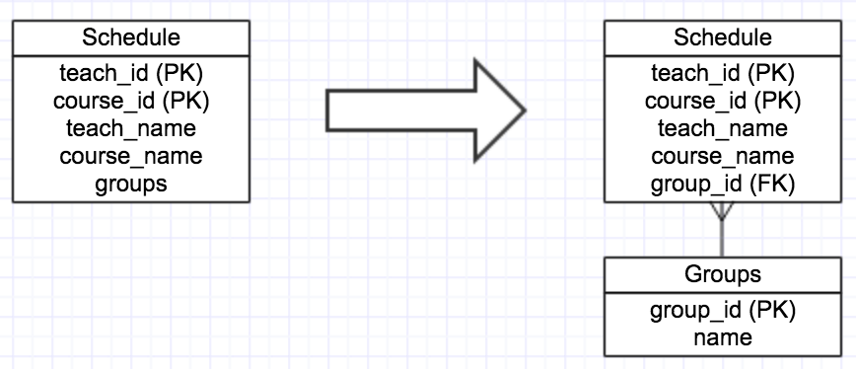
Case 1: UNF to 1NF (vers. 2)

Slide 28
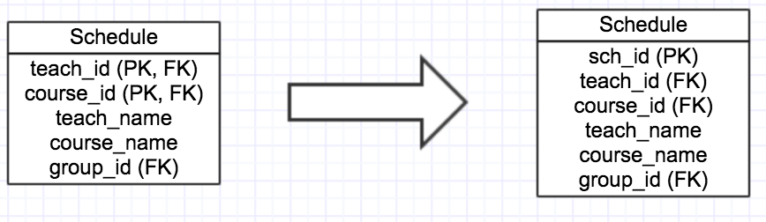
Case 2: 1NF to 2NF
Before:
FD1: {teach_id, course_id} -> {teach_name, course_name, group_id}
FD2: {teach_id} -> {teach_name}
FD3: {course_id} -> {course_name}

Slide 29
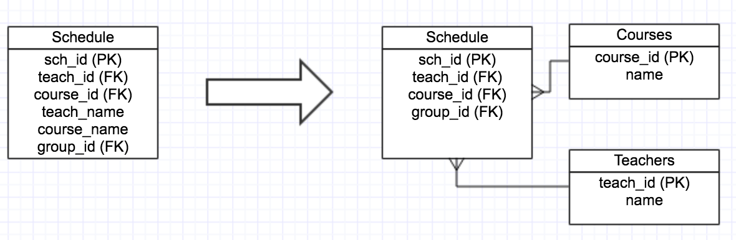
Case 3: 2NF to 3NF
Before:
FD1: {sch_id} -> {teach_id, course_id, teach_name, course_name, group_id}
FD2: {teach_id} -> {teach_name}
FD3: {course_id} -> {course_name}

Slide 30
Books
Connolly, Thomas M. Database Systems: A Practical Approach to Design, Implementation, and Management / Thomas M. Connolly, Carolyn E. Begg.- United States of America: Pearson Education
Garcia-Molina, H. Database system: The Complete Book / Hector Garcia-Molina.- United States of America: Pearson Prentice Hall
Sharma, N. Database Fundamentals: A book for the community by the community / Neeraj Sharma, Liviu Perniu.- Canada
E.F. Codd, "Further Normalization of the Data Base Relational Model"

Slide 31
Question
Through normalization, update anomalies
can be maximized
can be eliminated
is usually left unchanged
can be minimized but not eliminated

Slide 32
Question
Which of the following statements concerning normal forms is true?
A relation that is in second normal form is also in first normal form.
Each normal form contains a state of independent properties, unrelated to other normal forms.
The lower the normal form number, the better the schema design is.
Schemas that are in second normal form are considered the best.

Slide 33
Question
For a relation to be in 3NF, it should not contain _____ attribute that is transitively dependent on _____.
a non-primary key, the primary key
a primary key, a non-primary key
a primary key, a foreign key
a non-primary key, a foreign key

Slide 34
Question
Consider a table with atomic attributes A, B, and C and the following functional dependencies.
A -> B
B -> C
If the primary key of this table is attribute A, then this relation satisfies which of the following normal forms?
1. First
2. Second
3. Third
I and II only
I, II and III
I only
None

